Slide 1
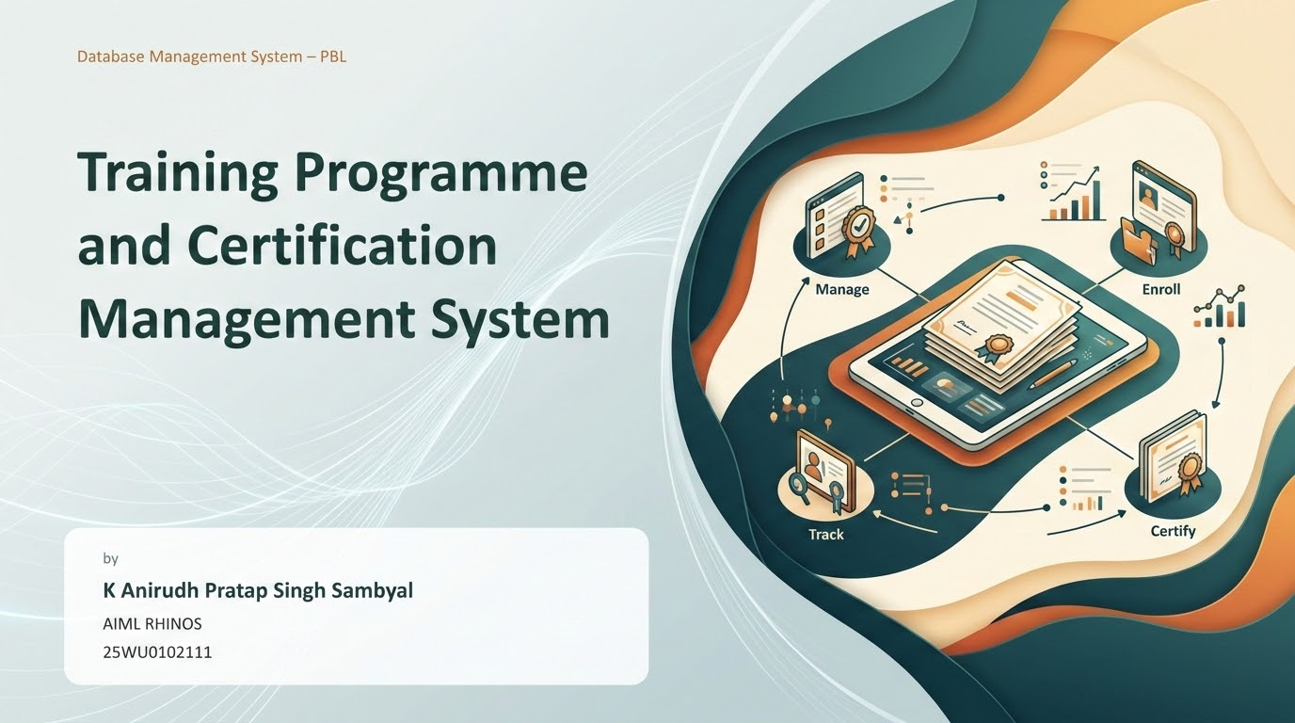
Database Management System – PBL
Training Programme
and Certification
Management System
by
K Anirudh Pratap Singh Sambyal
AIML RHINOS
25WU0102111

Slide 2
WHAT IS THE PROJECT?
Introduction
The Training Programme and Certification Management System is a database-based system designed to manage the complete training and certification process. It helps training centres manage enrolments, sessions, assessments and certificate issuance in an organized, centralized manner.
The system maintains
information about:
Courses & Modules
Trainers
Batches & Learners
Enrolments
Sessions & Attendance
Assessments
Certificates
Renewals

Slide 3
EXISTING PROBLEM
Problem Identification
In many training centres, programme information is managed using spreadsheets, documents or separate registers. This can lead to:
PROBLEM STATEMENT
To develop a centralized database management system that efficiently manages courses, batches, trainers, enrolments, sessions, attendance, assessments, certificates and renewals.
Manual systems make it difficult to enforce certificate eligibility and maintain consistent training records.
Difficulty managing large numbers of learners
Duplicate or incorrect enrolment records
Incorrect certificate eligibility decisions
Difficulty tracking session attendance
Difficulty monitoring assessments and scores
Time-consuming report and certificate generation

Slide 4
MAIN OBJECTIVES
Objectives
1
Maintain a centralized database of training programme records
6
Enforce certificate eligibility based on attendance and scores
2
Manage trainer and batch information efficiently
7
Issue and track unique certificate numbers and renewals
3
Handle learner enrolments and batch-capacity control
8
Generate useful training and performance reports
4
Track session schedules and attendance
9
Reduce duplicate and incorrect data entries
5
Record assessment scores and evaluate performance
10
Improve the efficiency of the certification process

Slide 5
THE SYSTEM WILL COVER
Scope of the Project
Course & Trainer Management
Learner Management
Course details & modules
Learner registration
Trainer profiles
Enrolment records
Batch setup & capacity
Attendance tracking
Assessment & Certification
Reporting
Assessment scheduling
Batch & attendance reports
Score recording
Performance analysis
Certificate issuance & renewal
Fee & certificate status

Slide 6
EXISTING APPROACHES VS PROPOSED SYSTEM
Literature Survey
Existing Approach
Limitations
PROPOSED SYSTEM PROVIDES
Manual registers
Time-consuming
Centralized training data
Excel spreadsheets
Data duplication
Automated eligibility enforcement
Separate learner files
Hard to integrate
Structured relational schema
Manual eligibility check
Possibility of errors
Faster learner & batch searching
Better data integrity & consistency
Manual certificates
Inconsistency
Automated certificate & report generation
Conclusion: Existing approaches can manage basic data, but a centralized relational database provides better organization, consistency and efficient retrieval of training and certification records.

Slide 7
SYSTEM WORKFLOW
Proposed System
Course Setup
Batch Creation
Learner Registration
Enrolment
Eligibility Check
→
→
→
→
↓
Certificate Issue
Score Recording
Assessment
Attendance Entry
Session Scheduling
←
←
←
←
This workflow illustrates the complete journey — from setting up a course and batch through to issuing a certificate — and is well suited for verbal explanation during the review.

Slide 8
THREE TYPES OF USERS
Users of the System
1
2
3
Training Administrator
Learner
Trainer
Manage courses and modules
View available batches
View assigned batches
Set up batches and capacity
Check eligibility
Record session attendance
Assign trainers to batches
Enrol in programmes
Conduct and record assessments
Define eligibility criteria
View attendance records
View learner performance
Issue and track certificates
View assessment results
Submit results
View results and generate reports
View issued certificates

Slide 9
SRS — THE SYSTEM SHOULD ALLOW
Functional Requirements
FR1
Admin can add, update and delete course and batch information.
FR7
Attendance can be recorded per session per learner.
FR2
Admin can add and manage trainer profiles.
FR8
Assessments and scores can be recorded per learner.
FR3
Batches have defined capacity and eligibility criteria.
FR9
Certificates can be issued to eligible learners.
FR4
Learners can be enrolled into available batches.
FR10
Certificate renewals can be tracked.
FR5
System can check learner eligibility for certification.
FR11
Users can search training and learner information.
FR6
Session schedules can be created and managed.
FR12
System can generate training and certification reports.

Slide 10
QUALITY ATTRIBUTES OF THE SYSTEM
Non-Functional Requirements
1
2
3
Performance
Security
Reliability
The system should retrieve training and certification records efficiently.
Only authorized users should be able to modify important training data.
The system should maintain accurate and consistent records at all times.
4
5
6
Usability
Scalability
Data Integrity
The application should have a simple and easy-to-use interface.
The database should handle increasing learners, batches and certificates.
Primary keys, foreign keys and constraints should prevent invalid data.

Slide 11
CORE ENTITIES IDENTIFIED IN THE PROJECT STATEMENT
Main Entities
Course
Module
Trainer
Batch
Learner
Enrolment
Session
Attendance
Assessment
Score
Fee
Certificate
Renewal

Slide 12
PROPOSED TABLES, KEYS AND RELATIONSHIPS
Initial Relational Schema
COURSE
MODULE
TRAINER
BATCH
Course_ID (PK)
Module_ID (PK)
Trainer_ID (PK)
Batch_ID (PK)
Course_Name
Course_ID (FK)
Name
Course_ID (FK)
Duration
Module_Name
Email
Trainer_ID (FK)
Category
Order
Specialization
Start_Date
Capacity
LEARNER
ENROLMENT
SESSION
ATTENDANCE
Learner_ID (PK)
Enrol_ID (PK)
Session_ID (PK)
Attend_ID (PK)
Name
Learner_ID (FK)
Batch_ID (FK)
Session_ID (FK)
Email
Batch_ID (FK)
Session_Date
Learner_ID (FK)
Phone
Enrol_Date
Topic
Status
Status
ASSESSMENT
SCORE
FEE
CERTIFICATE
Assess_ID (PK)
Score_ID (PK)
Fee_ID (PK)
Cert_ID (PK)
Batch_ID (FK)
Assess_ID (FK)
Learner_ID (FK)
Learner_ID (FK)
Assess_Date
Learner_ID (FK)
Amount
Batch_ID (FK)
Max_Marks
Marks_Scored
Payment_Date
Issue_Date
Cert_Number

Slide 13
FIVE PHASES FROM ANALYSIS TO REPORTING
Project Planning
1
2
3
4
5
Requirement
Analysis
Database
Design
Database
Implementation
Application
Development
Testing &
Reporting
Identify users
ER diagram
Create tables
Develop Python app
Test database
Identify entities
Relational schema
Add constraints
Connect to database
Test application
Define requirements
Functional dependencies
Insert sample data
CRUD operations
Generate reports
Define project scope
Normalization
Write SQL queries
Input validation
Prepare documentation

Slide 14
ASSESSMENT STRUCTURE
Review Framework
Review 1
Review 2
Review 3
Week 7
5 Marks
Week 11
5 Marks
Week 16
5 Marks
Problem Identification & Design
Implementation Progress
Final Demonstration
Problem identification, scope, objectives, users and functional requirements
Normalized database design up to 3NF with functional dependencies
Java or Python application connected to the database
Conceptual ER diagram covering all principal entities
DDL scripts with integrity constraints and sample data
Final demonstration: CRUD operations, search, validation and reports
Initial relational schema with proposed tables and primary keys
SQL queries demonstrating joins, subqueries, aggregation and views
Source code, database script, test data, project report and viva-voce

Slide 15
CONCLUSION
A centralized, structured system
for training and certification
The Training Programme and Certification Management System reduces manual work, improves data consistency, enforces certificate eligibility automatically and makes training information easier to manage and retrieve.
Thank You

